Slide 1
Counters

Slide 2
What are Counters?
Circuits for counting events are frequently used in computers and other digital systems. Since a counter circuit must remember its past states, it has to possess memory.
A counter driven by a clock is used to count the number of clock cycles.
There are two different types of Counters:
  Asynchronous Counters or Serial counters/Ripple counters
  Synchronous counters or Parallel counters

Slide 3
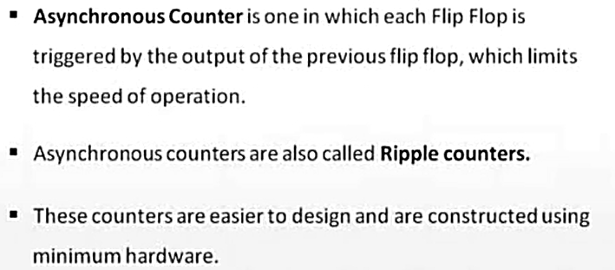
Asynchronous Counters

Slide 4
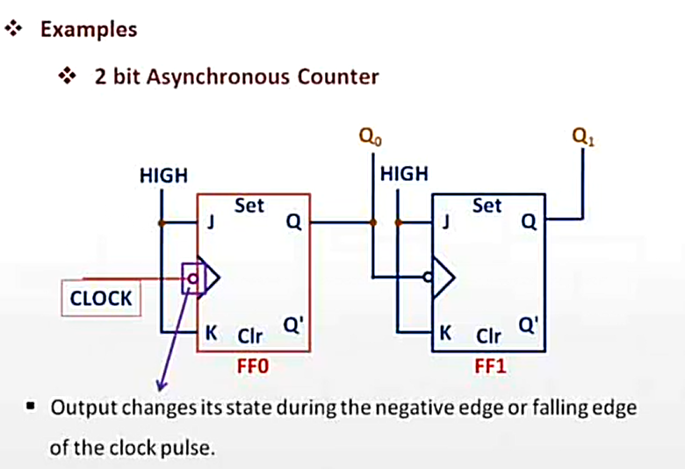
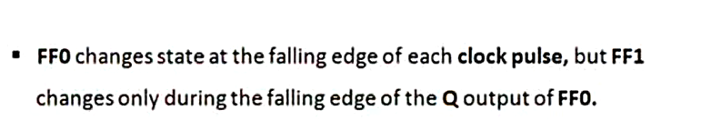

Slide 5
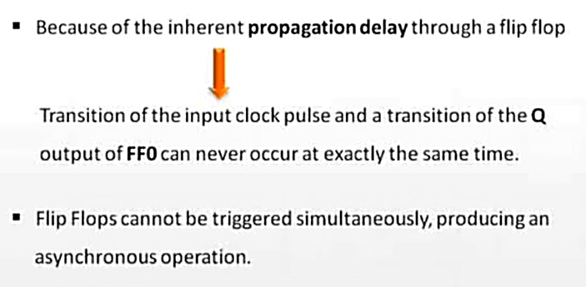

Slide 6
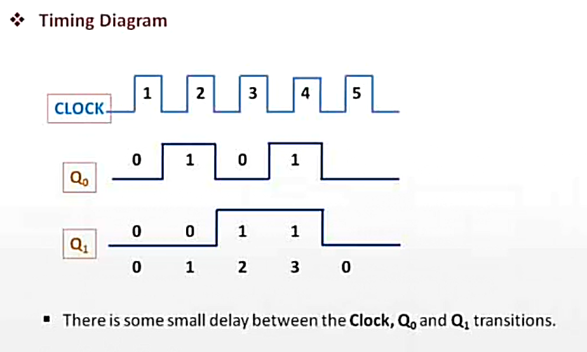

Slide 7
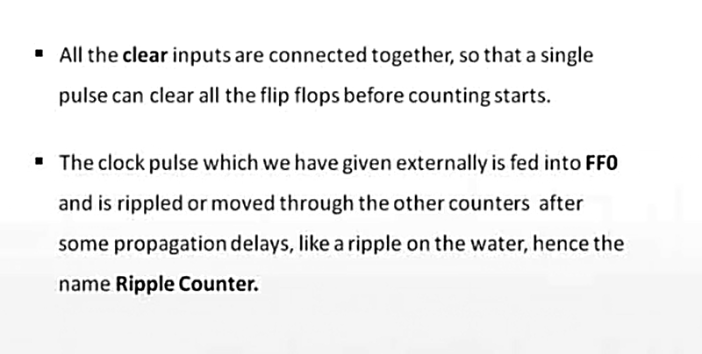

Slide 8
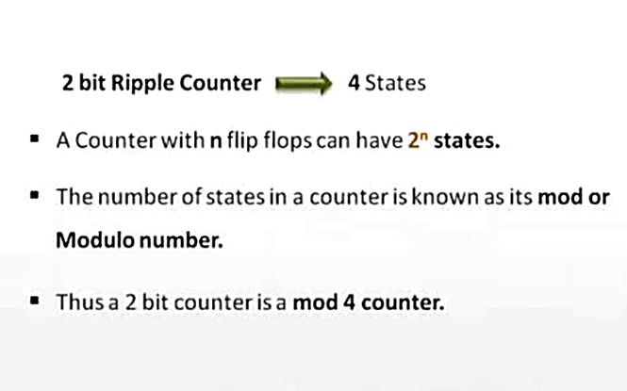

Slide 9
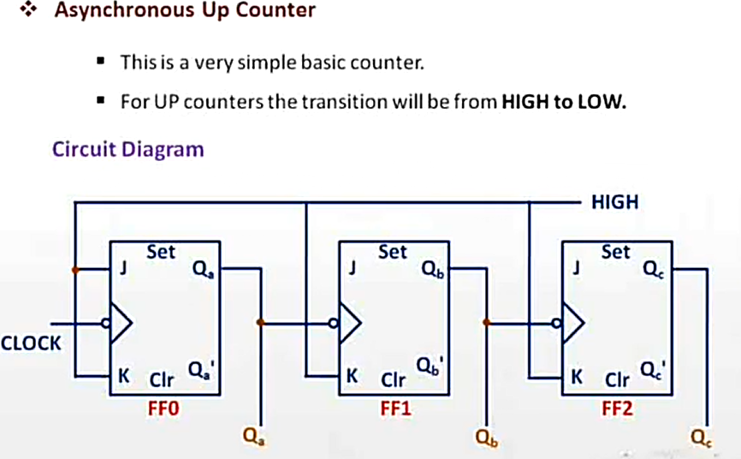
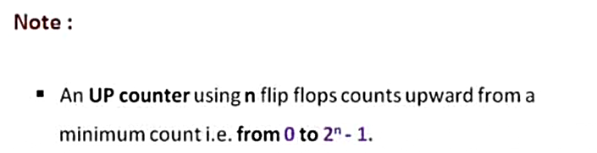

Slide 10
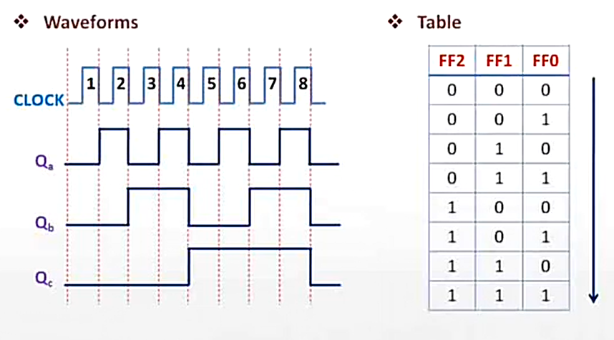
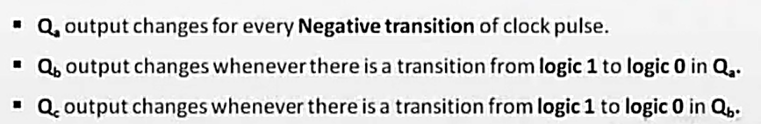

Slide 11
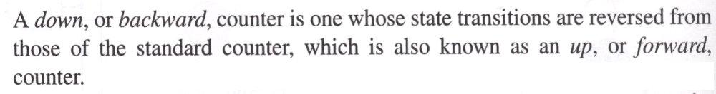
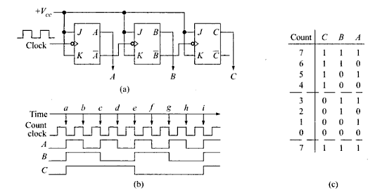

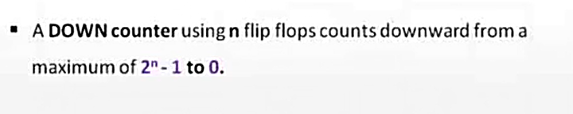
Asynchronous Down counters

Slide 12

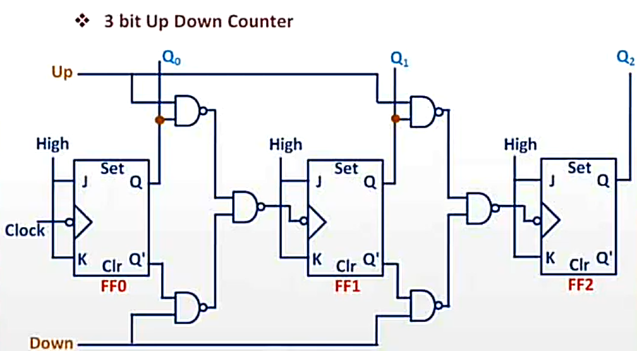

Slide 13
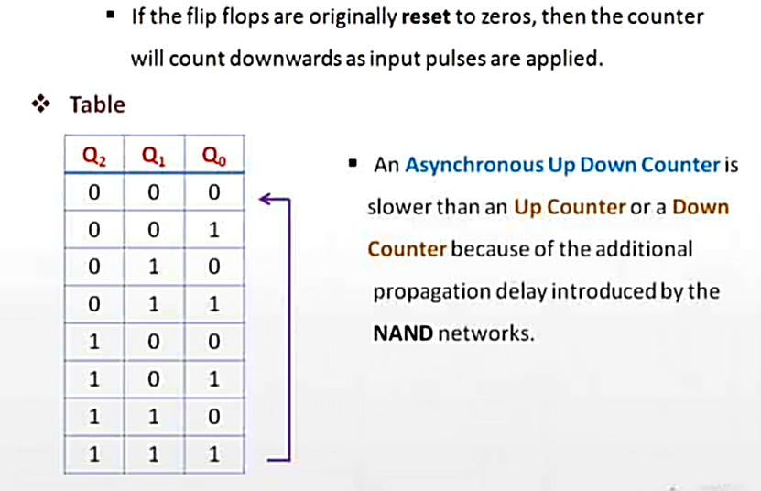

Slide 14
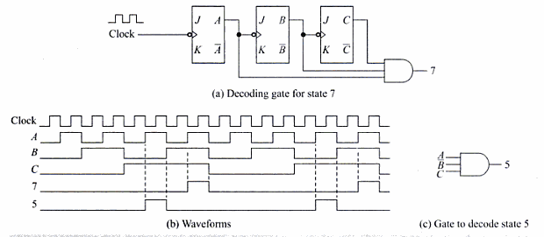
Decoding Gates

Slide 15
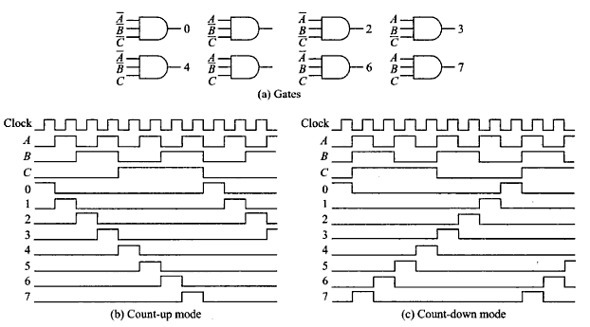

Slide 16
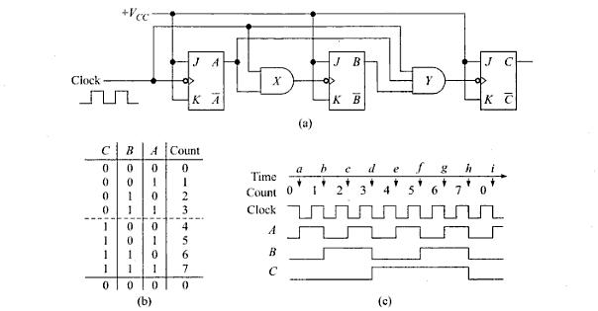
Synchronous Counters
In synchronous counters, the clock inputs of all the flip-flops are connected together and are triggered by the input pulses. Thus, all the flip-flops change state simultaneously (in parallel).

Slide 17
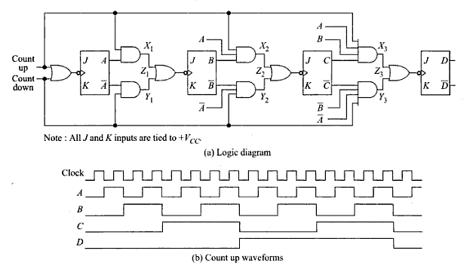
Synchronous UP/DOWN Counter

Slide 18
Changing the Counter Modulus
Natural count 2^{n} where ‘n’ is the number of flip flops
Constructing counters other than the one with a natural count, have modified count.
First necessary thing is to determine the number of flip flops required.
The correct no. of FFs is determined by choosing the lowest natural count that is greater than the desired modified count.

Slide 19
A mod-3 counter
Prior to ‘a’ on the time line A=0 and B=0. A negative clock transition @ ’a’ will cause:
  1. A to toggle to 1, since its J and K inputs are high
  2. B to reset to ), since J is low and K is high.
  Similarly prior to 1‘b’, A=2 and B=0. With the negative clock transition here:
  A toggles to 0 since its J and K are high
  B toggles to 1, since its J and K are high
  Now, prior to ‘c’ , A=0 and B=1
  A is reset to 0 since j=0 and k=1
  B is reset to 0 since j=0 and k=1
  This is referred to as divide by 3 block.

Slide 20
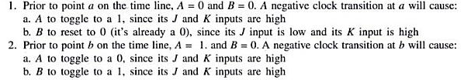

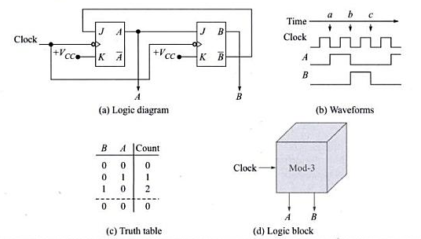

Slide 21
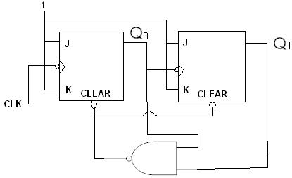
A mod-3 Counter

Slide 22
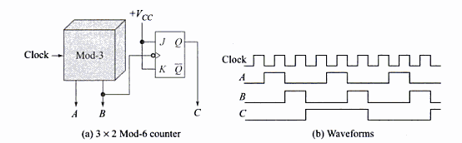
Similarly by skipping the respective counts we can build any modulus counters
For mod-12 we skip 4 counts
For mod-6, we skip two counts
For mod-5 we skip three counts

Slide 23
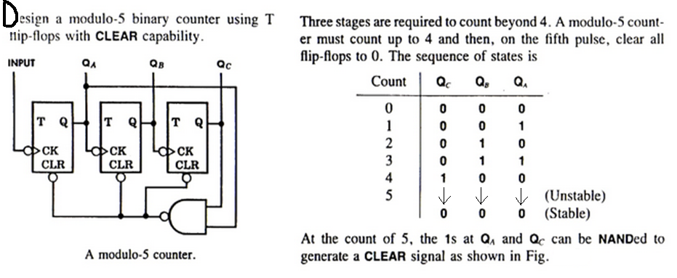
Mod-5 Counter

Slide 24
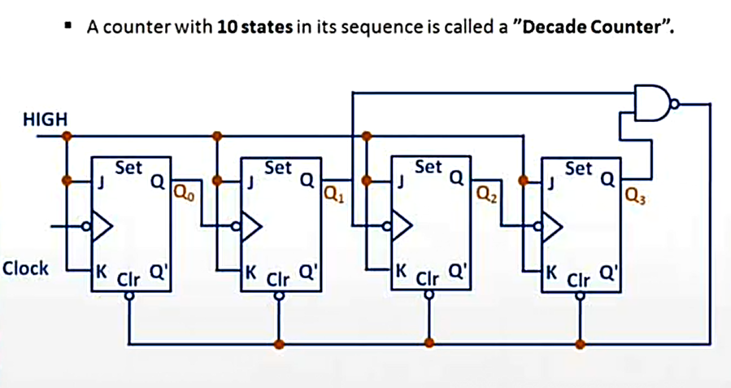
Decade Counter

Slide 25
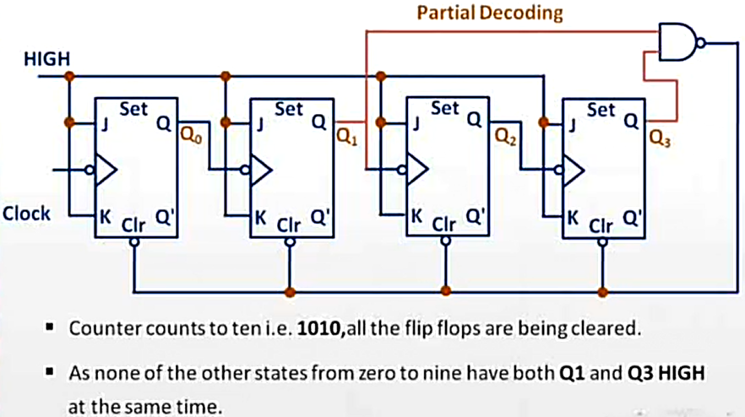

Slide 26
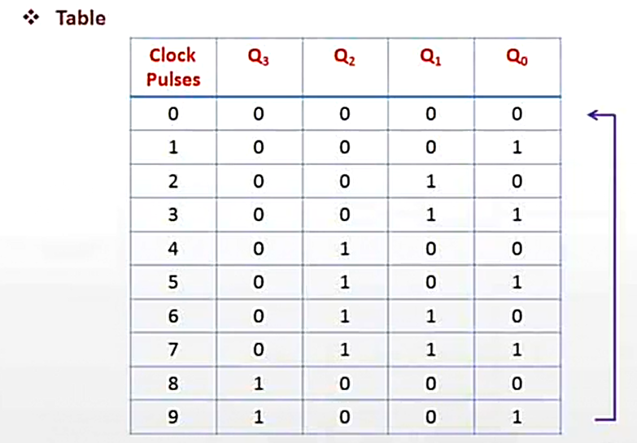

Slide 27
PRESETTABLE Counters
Many synchronous counters available as ICs are designed to be presettable. This means that they can be preset to any desired starting value. This can be done either asynchronously (independent of the clock signal or synchronously (on the active transition of the clock signal).
This presetting operation is also known as loading, hence the name loadable counter.

Slide 28
Count Sequence
Clk Q0
D0 Q1
D1 Q2
D2 Q3
D3
Load
Reset
Carry
Q3 | Q2 | Q1 | Q0
0 | 0 | 0 | 0
0 | 0 | 0 | 1
0 | 0 | 1 | 0
0 | 0 | 1 | 1
0 | 1 | 0 | 0
0 | 1 | 0 | 1
0 | 1 | 1 | 0
0 | 1 | 1 | 1
1 | 0 | 0 | 0
1 | 0 | 0 | 1
1 | 0 | 1 | 0
1 | 0 | 1 | 1
1 | 1 | 0 | 0
1 | 1 | 0 | 1
1 | 1 | 1 | 0
1 | 1 | 1 | 1
IC 54/74163 can be used as a 4-bit presettable counter.

Slide 29
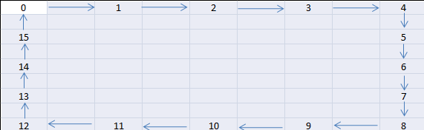
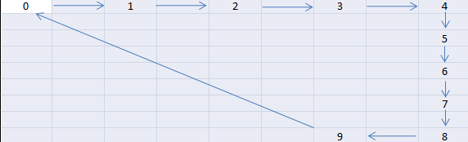
The count length can easily be modified by making use of Clear/Reset input
Mod-16 counter state diagram Mod-10 counter state diagram

Slide 30
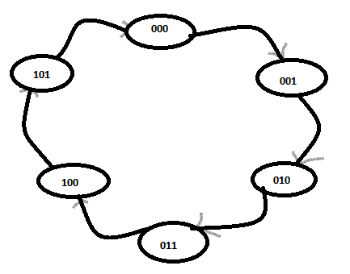
Counter Design as a Synthesis Problem

Slide 31
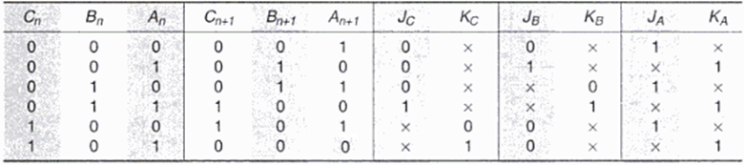
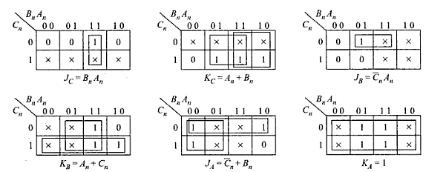
Derive the equations using K-maps

Slide 32
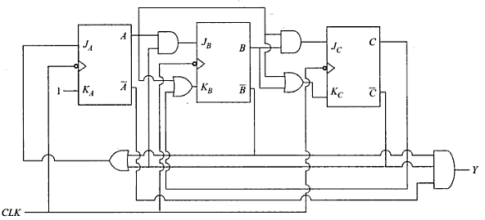
Finally Design the CKT diagram

Slide 33
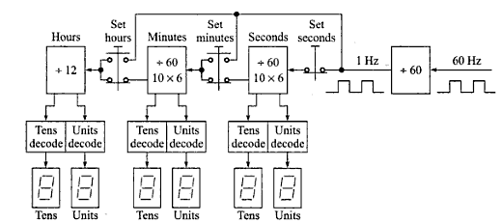
Application of Counters
Designing Digital clock which displays hours, minutes and seconds.

Slide 34
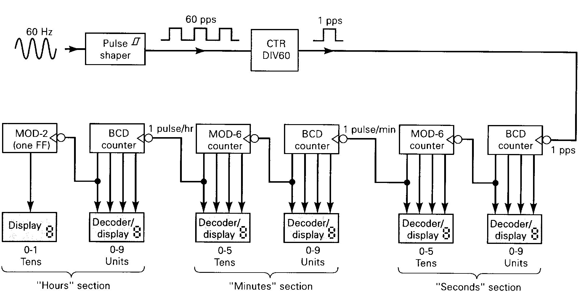

Slide 35
